Slide 1


Household budget

Slide 2
What is Household Budgeting
Household Budget is a forecast of planned income, spending, and saving of the household.
The budget is generally for one year.
It’s the parents’ primary task to prepare a household budget.
The main purpose of a household budget is to lead a balanced life without incurring any debt to the extent possible.

Slide 3
Classification of budget
Needs
  Approximately half of your income should be set aside for the essentials, the core things you need to live.
  These include utilities, groceries, rent, prescription medications, cooking gas, petrol for you scooter/car, FMB Hub etc.
Saving and Debts
  The allocation to this category will depend on your long term goals and your past borrowings, which need to be repaid.
Wants
  Anything remaining after budgeting for your needs, saving, and debts should be spent on things that you want but could live without.
  Wants generally include money for vacations, car etc.

Slide 4
Importance of HH Budget → Future Oriented
A budget helps you figure out your long-term goals and work towards them.
A budget forces you to map out your goals, save your money, keep track of your progress and make your dreams a reality.
OK, so it may feel sad when you realize that brand new Xbox game or the gorgeous cashmere sweater in the store window doesn't fit into your budget. But when you remind yourself that you're saving up for a new house, it will be much easier to turn around and walk out of the store empty-handed.

Slide 5
Importance of HH budget → Ensures you don’t spend money that you don’t have
Thanks to proliferation of credit cards, far too many of us spend money that we don’t have.
These days, people who overuse and abuse credit cards don't always realize they're overspending until they're drowning in debt.
Average credit card debt per household in the US stood at USD 8377 in 2016.
However, if you create and stick to a budget, you'll never find yourself in this precarious position. You'll know exactly how much money you earn, how much you can afford to spend each month and how much you need to save.

Slide 6
Importance of HH budget → Helps you prepare for emergencies
Life is filled with uncertainties. Emergencies can push one into financial turmoil.
Emergencies always arise at the worst possible time – when you're already strapped for cash. This is exactly why everyone needs an emergency fund.

Slide 7
Budgeting Process → Set Your Goals
The budgeting process should start with the family sitting together and agreeing on what are the goals for the family for short term, medium term and long term. E.g.:
  Becoming debt free
  Getting in shape/becoming healthier
  Sending children to Jamea
  Haj
  Ziyarat maqamat muqaddasa
  Ashara mubaraka with Aqa Moula (TUS)
  Increase in wajebaat
  Contribution to Qardan Hasana

Slide 8
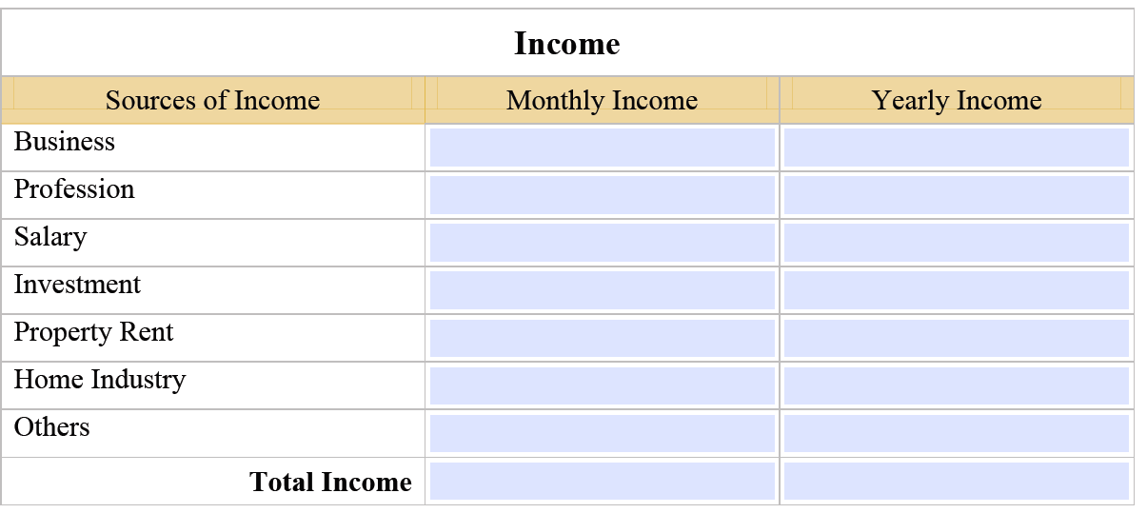
Budgeting for Income

Slide 9
Budgeting for Expenses
Determine your projected monthly and yearly expenses under ‘the 6 Umoor.’
This method allows you to organize your expenses in a way that comprehensively encompasses the various activities of a Mumin’s life.
  Deeni – i.e. Khumus, Wajebaat, FMB, Hajj, Ziyarat
  Housing – i.e. Utilities, House Maintenance, Kitchen Utensils
  Food – i.e. Groceries, Dining
  Livelihood – i.e. Personal & Family Care, Transportation
  Education – i.e. School/ College Fees
  Health – i.e. Medical/Dental, Eye Care, Leisure

Slide 10
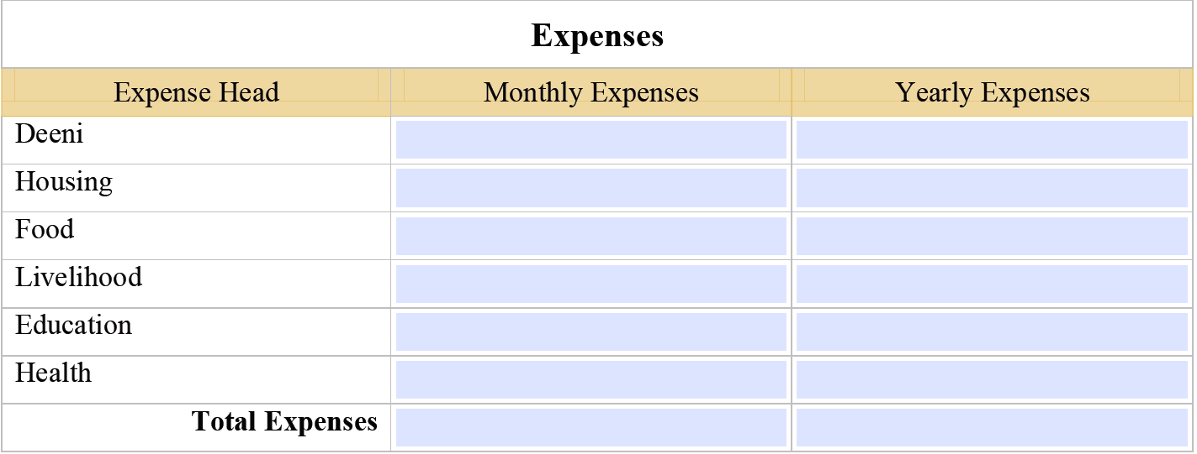
Budgeting for Expenses (contd..)

Slide 11
Tracking the Budget
Once the budget is balanced, save it in a computer file or in a book.
Start tracking actual expenses against the budget.
  Ensure each expense in backed up by a receipt/invoice etc.
  If there are expenses which are in the nature of future provision, enter the amount in the respective category and set aside equivalent cash. E.g. provision for Wajebaat, Ziyarat etc.
  Enter the actual expense under the same category where it is budgeted.
If the monthly actual expenditure is more than the monthly budget, make sure that future months’ budget is reduced so that overall budget for the year remains the same.

Slide 12
Things to Remember
Inflation
  Inflation is increase in prices of commodities and other consumable items. Generally the prices go up by 10% every year. So, it would be wise to budget a 10% increase in next year’s budget compared to last year for food and utilities.
Continuously review the budget
  The budget and actual expenditure should be reviewed every month to make sure that expenses are happening as per budget.
  Keep prioritizing expenses every month to identify any unnecessary expense.
Avoid borrowing as far as possible
  Every mumin should try to stay within his means.

Slide 13
Barriers to Family Budgeting
Finance is generally a sensitive topic for a joint family.
Family members may not be fully transparent.
Everyone wants his needs to be prioritized.
Saving is someone else’s problem.
Future is too far. Bukra Allallah!!

Slide 14
THANK YOU

