Slide 1

Formation of a Counselor’s Team

Slide 2

Why Counseling?
Help mumineen to Start Business
Assist in overcoming Hurdles & Challenges
Help understand the market conditions and adapt in such situations
Educate to use modern tools and techniques to increase sales, productivity & profitability
Assist in managing finances optimally

Slide 3
Who Is
A
COUNSELOR
?

Slide 4


1
An advisor who has an extensive experience in handling business

Slide 5

2
Profitability, Sustainability & Growth
Analyze Current Situation
Identify Areas of Improvement
Systematic & Professional Approach
Enhance Business Performance

Slide 6

3
Guide mumineen as per Hidaayat of Aqa Maula TUS &
Dedicated to perform khidmat to achieve Khushi Mubarak of Aqa Maula TUS

Slide 7
COUNSELORS REQUIRED AT MAUZE / ZBC LEVEL
Number of counselor required from each mauze is 1-200 houses.
The counselor should be well aware of the market and political conditions, in regards to business scenario of respective mawaze.
The age limit of a counselor is expected to be not less than 25 years.
He/she should have basic knowledge about counseling, should be a good listener and be good in maintaining relationships.
There should be atleast 2-3 female counselor for the entire zone

Slide 8
Education & Experience Required
The counselor should be well experienced in handling all areas of business such as building business plans, developing strategies, in marketing, sales, in organisation structure, with finance having special emphasis on cash flow, inventory management, logistics management, effective production systems such as floor management, employee management and customers / supplier relationship management.
He/she should be well informed about various business trends in the market at both macro and micro levels.
He/she should have excellent analytical skills, problem solving skills and strong attention to detail
He/she should be well educated and have knowledge of various business tools, exposure to I-T systems, internet/communication usage
He/she should be highly compassionate, matured with good listening skills, have high level of empathy, be goal oriented, visionary with fairly good leadership skill, have good communication skills both in English and LisanulDaawat and must have a passion to mentor.
He/she should have a sound understanding of relevant tax laws of the country, halal/haram in business as per law of Shariatgharraa’ and contextual understanding of bayans/instructions from AqaMaula (TUS) and related authorities.
It is not essential, but having good ability to conduct training on the relevant business topics is highly desirable

Slide 9
Roles & Responsibilities of A Counselor
Understand Business Issues & Analyse Business Problem
Provide Recommendations & Chart out Action Plan
Implement & Monitor The Performance, Take corrective actions if required.
Update Administrator
Pro-active in initiating new activities & support initiatives

Slide 10
Milestones
Nomination of Counselors
Expertise Analysis
Training
Initiate Counseling
Onboarding

Slide 11
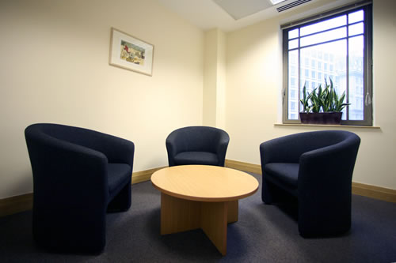

What Facilities would you require for Counseling?

Slide 12
Any Questions?

Slide 13
Thank You

