Slide 1

Cash business
BDD Seminar Series
July 2020

Slide 2
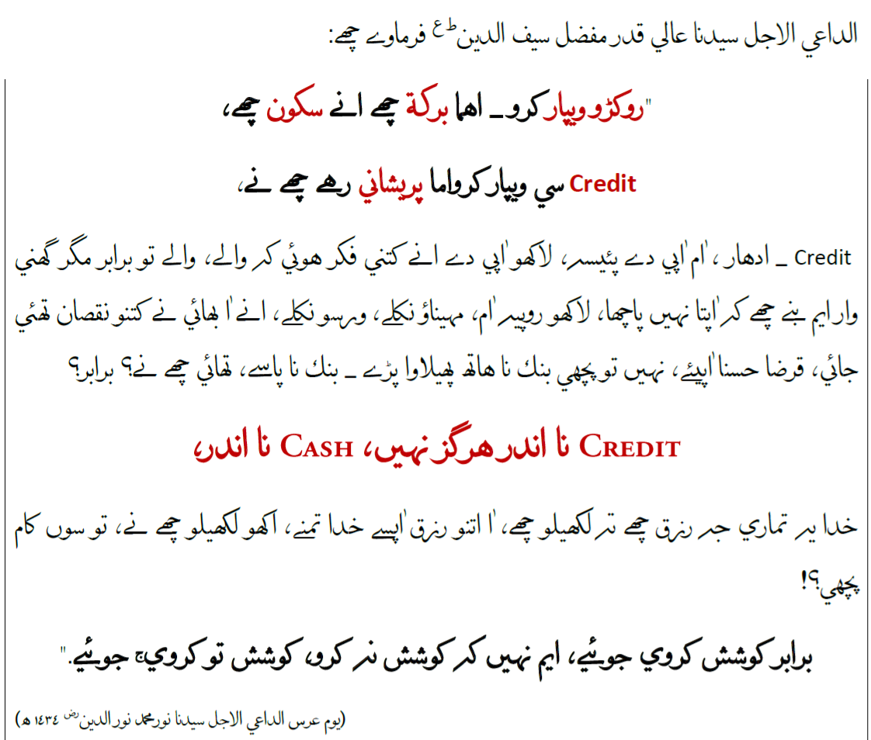
Noorani Kalemaat

Slide 3
Approach
Belief
Develop your ‘Master Plan’
Step by step implementation
Revisit and improvise

Slide 4
Belief….. نعمة بلا سؤال
Al fiqho thummal matjar – what is fiqh?
Capital
Dai ni doa mubarak
Methodology
Ethical
Aim
Shah saudagari

Slide 5
Prepare your master plan … components
Purchase
Inventory
Sales

Slide 6
Master Plan … purchase
Understand the supplier market
Immediate ‘halt’ on credit purchase
List payables of purchases on pareto basis
Design and agree on repayment plan based on cut off date with new supplies on cash basis
Pledge cash purchase in future
Negotiate better prices from suppliers
How to raise capital:
Internally (frozen investment / overstocking etc
Qardan Hasana

Slide 7
Master Plan … sales
Understand the customer market
Immediate ‘halt’ on credit sales
List receivables - analyze and categorize (pareto)
Design a plan to bring them towards cash (e.g.)
Aggressive payment collection
An example:
Category A – loyal customers
Category B – repayment plan on previous credit – new terms (90 – 45 – 0)
Category C – convert immediately to cash (risk of loosing customers – risk mitigation)

Slide 8
Master Plan … inventory
Analyze current stocks – categorize and plan
    Fast moving
    Profitable
    Slow moving / Dead
Return or exchange
Sale at discounted rates
Bundle off

Slide 9
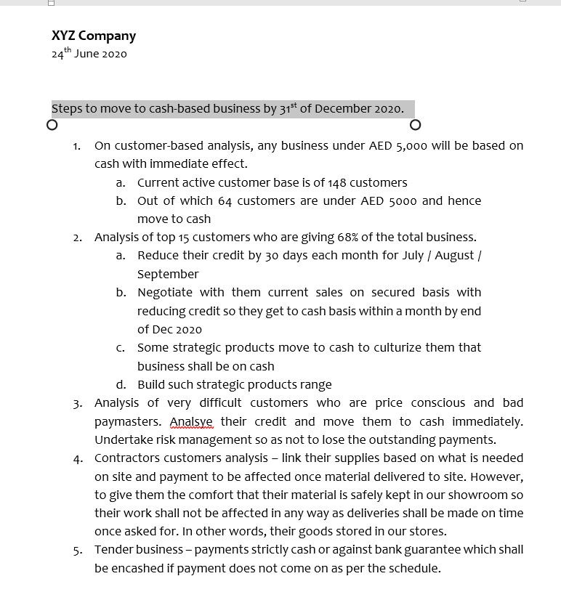

Slide 10
Business impact
Purchase
Inventory
Sales
Business is in our control
Improvement in profitability
  Lower costs (holding cost)
  Lower expenses (stock management / sales team / commissions)
Peaceful (religiously / personally)
Focus on excellence (strategic planning)
Inventory Management
Prudent
Business Budgeting
Strategic plan
Budget Monitoring and Control
Disciplined growth
JIT
Cost effective
Business oriented
Operational plan
Husn
Itqaan
Iffat

Slide 11
Some tips
Credit market is a conditioning – we have the power to reverse it
There are markets which accept your way of working and that is where growth potential lies

Slide 12
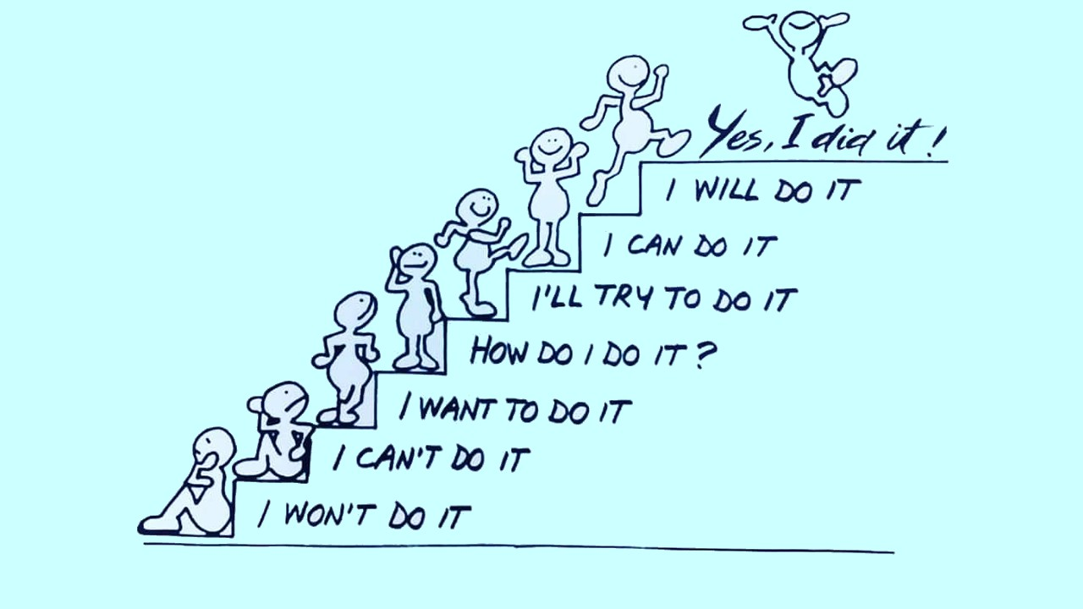

Slide 13
Thank you
Q / A
Contact:
trpakistan@alvazarat.org

